Slide 1
Diet and CRC prognosis
Food
Gut microbiota
CRC prognosis
Food frequency questionnaires (FFQ) were obtained for
114 of 333 CRC patients (209 variables)

Slide 2
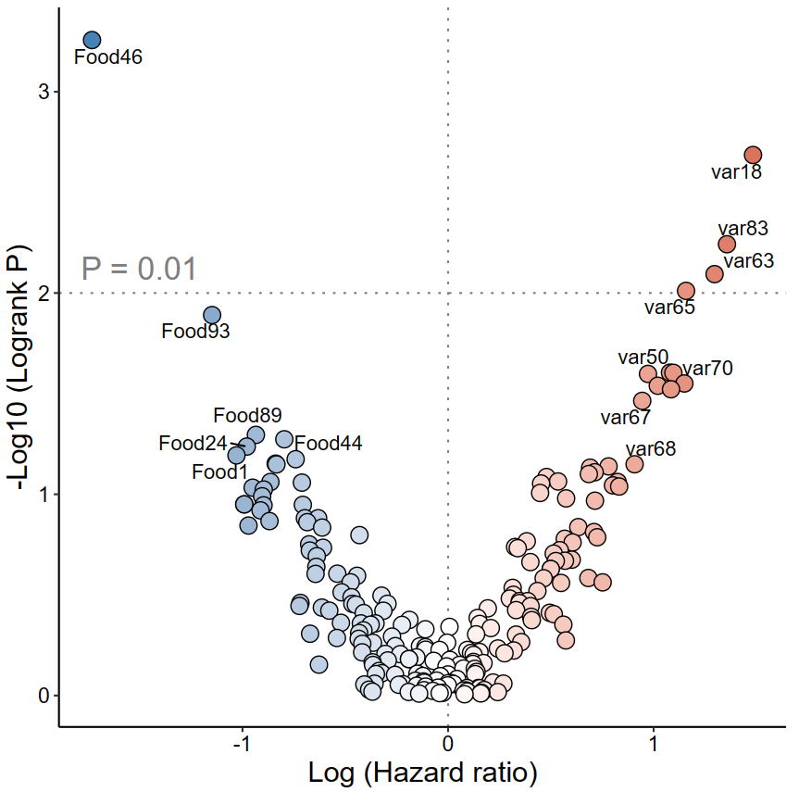
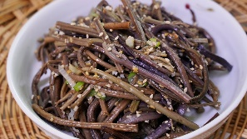
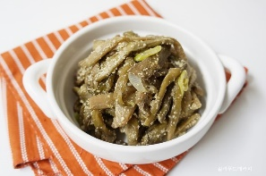
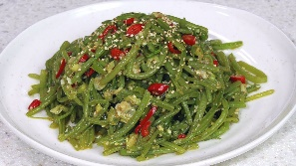
Screening prognosis-associated food
X: Hazard ratio (multivariate Cox considering stage)
Y: P-value (log-rank test)
Food46 include
Retinol
Bracken (고사리)
Vitamin D
Methionine
Leucine
Taro stem (토란대)
Sweet potato
stalk (고구마 줄기)
Beneficial
Harmful

Slide 3
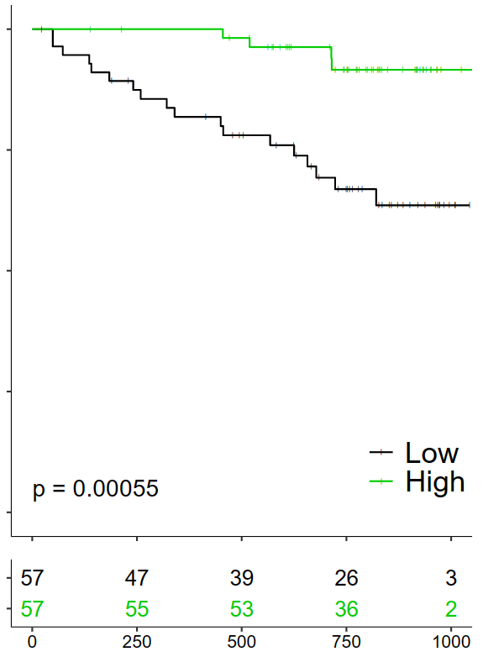
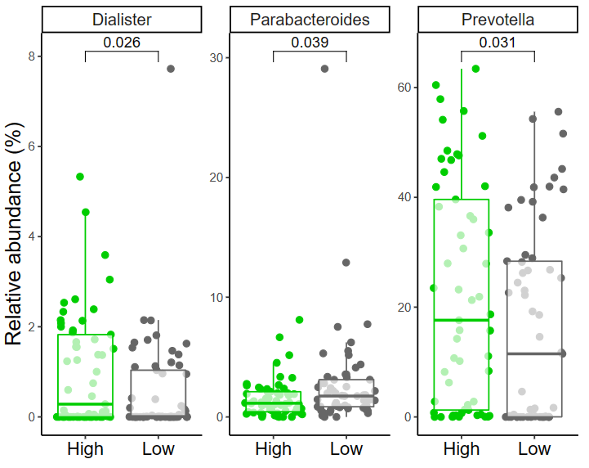

Does Food46 affect CRC prognosis via gut microbiota?
Food46
Progression-free survival
Low
High
Days

Slide 4
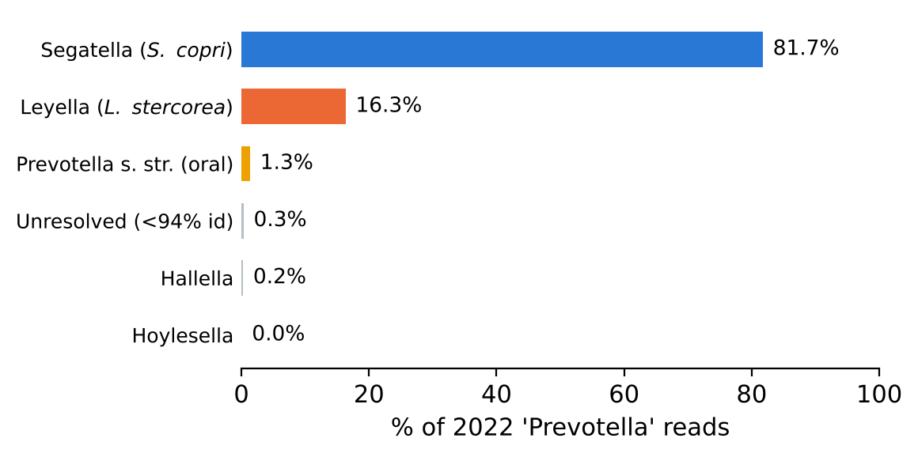
Need to confirm
Prevotella degrades dietary fiber, and is no longer one genus
Segatella copri, formerly Prevotella copri, carries an unusually large set of xylan and arabinoxylan loci (GH10, GH43, GH51) and expands selectively on whole grains and plant-rich diets
Hitch et al. (Syst Appl Microbiol 2022;45:126354) split Prevotella on genomic grounds into Segatella, Leyella, Hoylesella, Hallella and others.
  The names were validated in IJSEM in 2023 and are used by GTDB and SILVA 138.2
Leyella stercorea, formerly Prevotella stercorea, is specific to the human gut and produces succinate and acetate. Almost nothing is published on its substrate preferences
Any "Prevotella enterotype" derived from 2021-era SILVA therefore pools at least two genera whose biology differs
Reads previously called Prevotella in this cohort, reassigned against the 56 type-strain references.

Slide 5
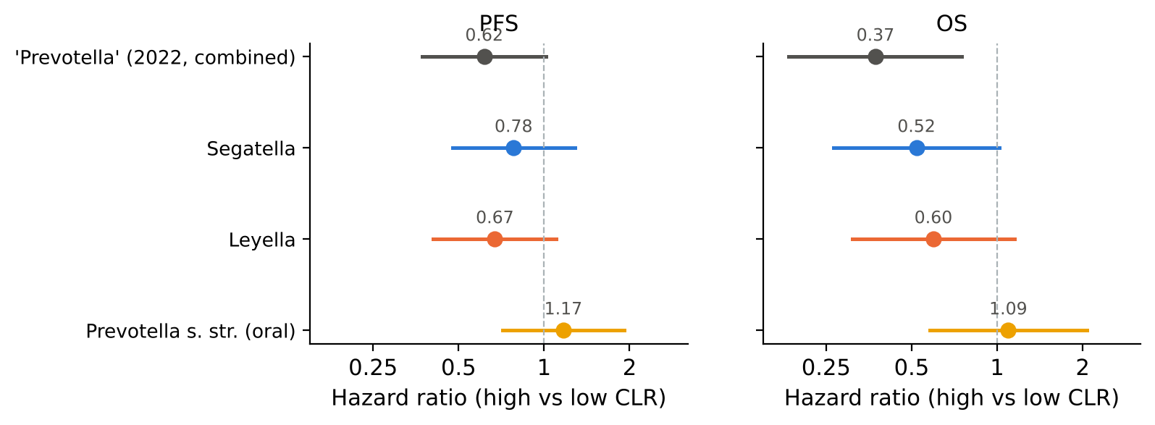
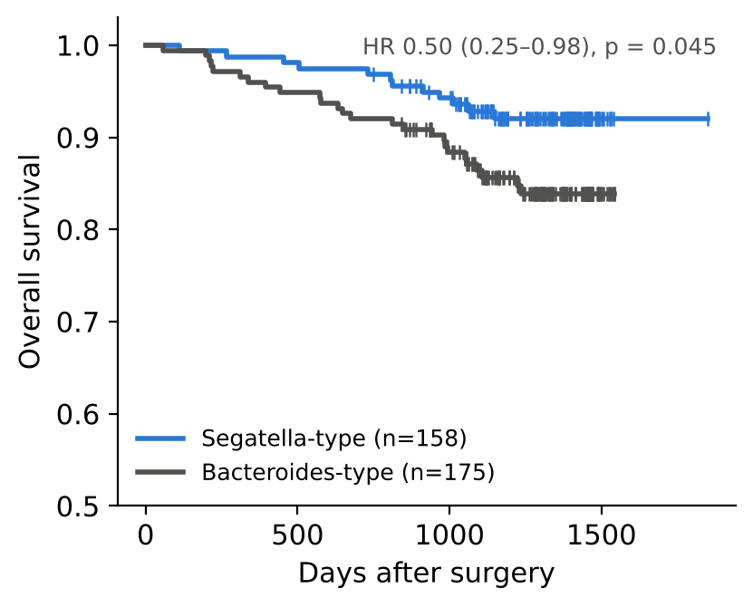
Need to confirm
The protective signal splits across two genera
Both gut genera point the same way, while the oral Prevotella clade points the other way
  The 2022 combined variable was significant largely because it summed the two gut genera
Re-deriving enterotypes by PAM clustering on Jensen-Shannon distance reproduces the 2022 survival difference, with overall survival HR 0.50 (0.25 to 0.98)
Separating the oral clade from the gut clades is itself a contribution relative to the 2022 paper

Slide 6
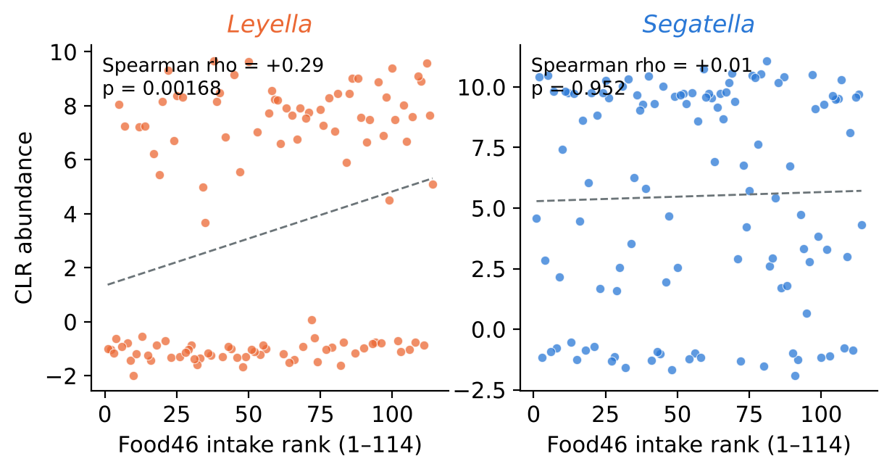
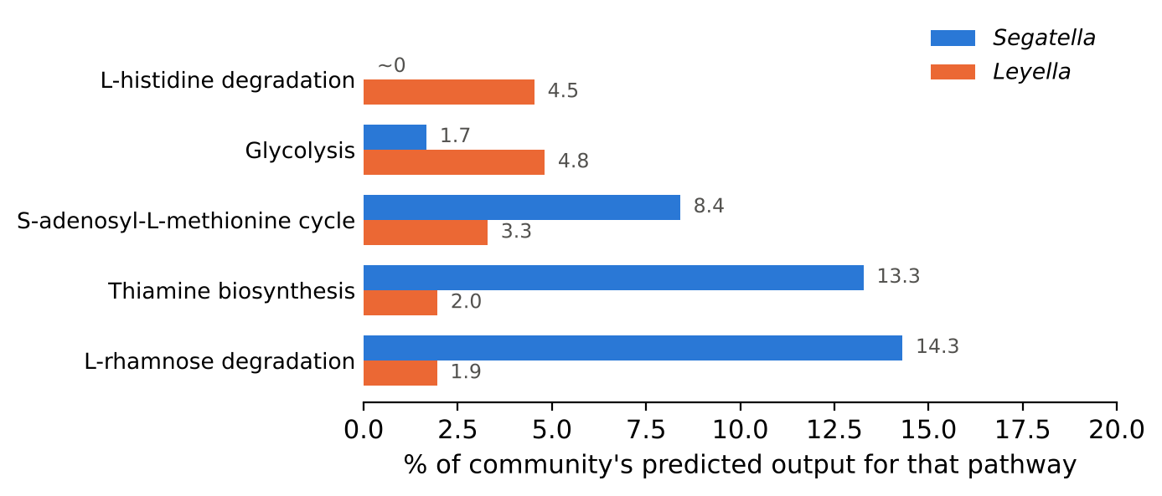
Need to confirm
Status 3. Food46 tracks Leyella rather than Segatella
Across 70 genera present in at least 20% of samples, Leyella ranked first (Spearman rho 0.29, FDR 0.16) while Segatella showed no association at all.
The two mechanisms nominated in 2022 also separate between the genera: thiamine biosynthesis is almost entirely Segatella, and histidine degradation almost entirely Leyella.
Food46 remains associated with survival after adjusting for either genus, so this is not mediation. The two observations should be reported separately.

